Slide 1

Prepared by BBA-BI students:
1.Pawan Bhandari
2.Roshan Kumar Sharki
3.Salil Subedi
4.Md Sejan Mikrani
5.Dharmendra Shah
6.Sangam Chand

Slide 2
Meaning……….
The statement which records the flow of company’s cash and has been an integral part of every business is called cash flow statements.
With the cash flow statement, investors know about the utilization of their money. A cash flow statement can be utilized to measure the future cash flow of the business, which can aid in budgeting purposes.

Slide 3
Purposes of cash flow statement:
To measure the arithmetic accuracy of entries mode.
To act as basis of financial statements.
To summarize the accounting.
To assess the company’s ability to generate positive cash flows in the future.
To assess its ability to met its obligations to provide service, payment of loans, payment of dividends etc.
To assess the reason for differences between reported revenues/expenses and the actual cash flows.
To assess the effect of major transactions on the financial conditions of a company’s
To expalin the causes for changes in the cash balance during the year.

Slide 4
Importance of cash flow statements
1.Assessing Liquidity: Cash flow statements help evaluate a company's ability to meet its short-term obligations and manage its day-to-day operations.
Tracking Cash Sources and Uses: Cash flow statements track the various sources and uses of cash within a business.
Identifying Cash Flow Trends: By comparing cash flow statements over different periods, stakeholders can identify trends and patterns in a company's cash flow.
Supporting Investment Decisions: Cash flow statements assist investors in assessing the attractiveness of an investment opportunity.
5.Evaluating Cash Conversion Efficiency: The cash flow statement allows businesses to evaluate how effectively they convert their sales and profits into cash.
6.Facilitating Financial Planning: Cash flow statements serve as a foundation for financial planning and budgeting.

Slide 5
Importance of cash flow statements
7.Facilitating Financial Planning: Cash flow statements serve as a foundation for financial planning and budgeting.

Slide 6
Cash flow from operating activities.
Cash flow from operating activities is an important financial metric that measures the amount of cash generated or used by a company's core business operations. It reflects the cash inflows and outflows directly related to the company's ongoing operations, such as sales revenue, expenses, and taxes.
Importance: Cash flow from operating activities is an important measure of a company's financial health and sustainability.
Interpretation: A positive cash flow from operating activities is generally considered a good sign, while a negative cash flow from operating activities may indicate underlying issues in the company's operations, such as declining sales, rising costs, or poor management of working capital.
Limitations: While cash flow from operating activities is an important metric, it is not a comprehensive measure of a company's financial performance.
Analysis: When analyzing cash flow from operating activities, it is important to consider trends over time and compare the company's performance to its peers and industry averages.

Slide 7
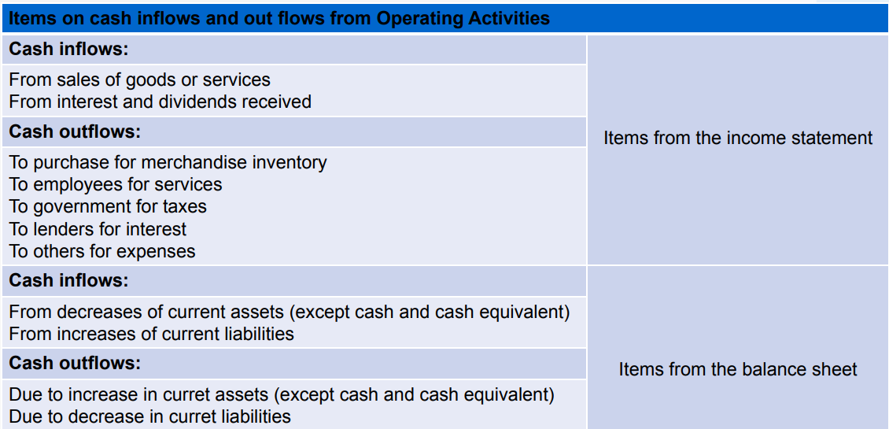

Slide 8
Cash flow from Financial activities
Cash flow from financial activities refers to the inflows and outflows of cash resulting from financial transactions that affect the capital structure of a company. It represents the cash generated or used by activities such as borrowing, issuing stock, repaying debt, paying dividends, and making investments in financial instruments. Here are some key components of cash flow from financial activities:
Issuing or Repaying Debt: When a company issues bonds, takes out loans, or issues other debt instruments, it receives cash inflows. Conversely, when the company repays its debt, it results in cash outflows.
Equity Financing: Cash inflows can occur when a company issues new shares of stock through an initial public offering (IPO) or secondary offerings. Conversely, repurchasing shares through buybacks leads to cash outflows.

Slide 9
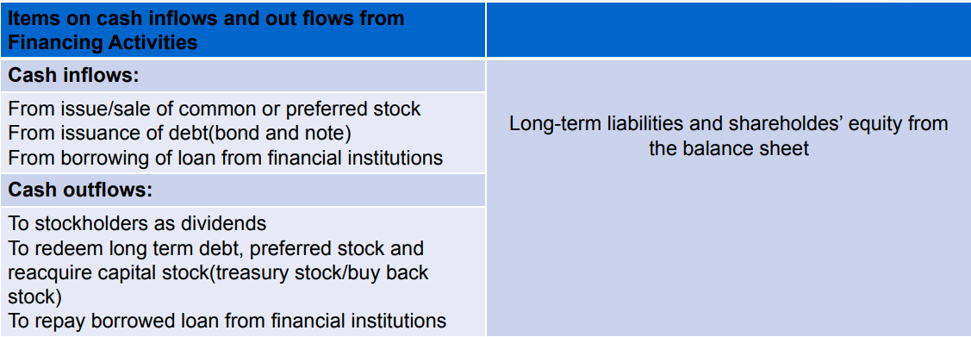

Slide 10
Cash flow from investing activities
cash flow from investing activities is a financial metric that measures the cash inflows and outflows related to a company's investments in assets such as property, plant, and equipment, acquisitions, and investments in other companies. When presenting cash flow from investing activities here are some key points to keep in mind.
Importance: Emphasize the importance of cash flow from investing activities in assessing a company's capital expenditures and growth prospects.
Comparison: Compare the company's cash flow from investing activities to its peers or industry averages. This can provide insights into how the company is investing its resources relative to its competitors and whether it is making more or less efficient use of its capital.
Risks and Opportunities: Discuss any risks or opportunities that may impact the company's cash flow from investing activities in the future. For example, changes in industry conditions, regulatory changes, or shifts in consumer behavior could impact the company's ability to invest in its operations and grow its business.

Slide 11
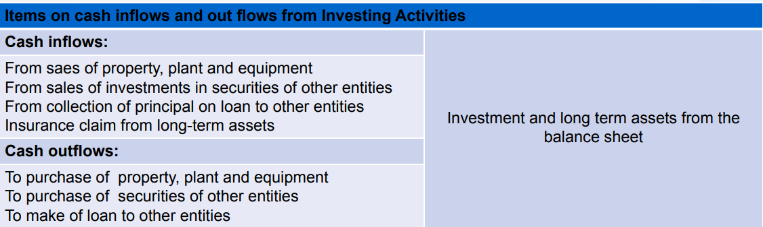

Slide 12
Format of Cash flow statement under indirect Method
Particular
Operating Activities: Net income before tax……………………………………………………………………………………….... Add: Adjustment for non cash and non operating expenses/items Depreciation…………………………………………………………………………………………………………… Written off or amoritization of intangible asset and fictitious asset…………………… loss on sale of disposal of fixed asset and investment…………………………………………. Premium on redemption of preference share and debentures…………………………….. less: Adjustment for non-cash and non operating incomes/items income from investments………………………………………………………………………………………. Appreciation………………………………………………………………………………………………………….. Reserve written back…………………………………………………………………………………………….. Gain on sales of fixed asset and investment……………………………………………………….. discount on redemption of preference share and debentures……………………………. Operating profit before working capital changes Add: Decreases in current assets(except cash and equivalent)…………………………….... Increase in current liabilities(except bank overdraft………………………………………. Less: Increase in current assets(except cash and cash equivalent)…………………………… Decrease in current liabilities(except bank overdraft)……………………………………. Cash generated from operating before tax Less: Income tax paid…………………………………………………………………………………………………… Add/less: Extra ordinary items(if any) ………………………………………………………………………..
Net cash flow from operating activities……………………………………………………………………..
Amount | Amount
xxx xxx xxx xxx | xxx xxx
xxx xxx xxx xxx xx | xxx xxx
xxx xxx | xxx xxx
xxx xxx | xxx
 | xxx xxx xxx
 | xxx

Slide 13
Numerical
Capital and liabilities | 01/01/2009 (Rs) | 31/12/2009 (Rs) | Asset | 01/01/2009 (Rs) | 31/12/2009 (Rs)
Share capital 10% Debenture Bank loan Accounts payable Wages accrued Tax provision Dividend provision Retained earning | 800,000 200,000 100,000 100,000 50,000 50,000 100,000 __________ | 1,000,000 100,000 300,000 100,000 20,000 60,000 60,000 120,000 | Land and building Plant and machinery Accumulated depreciation Inventories Account receivable Prepaid insurance Cash at bank Cash at hand | 500,000 650,000 (100,000) 100,000 150,000 10,000 80,000 10,000 | 700,000 800,000 (140,000) 150,000 200,000 20,000 25,000 5000
 | 1,400,000 | 1,760,000 |  | 1,400,000 | 1,760,000
Additional information :
Sales revenue (net of Rs 100,000 returned from customer) was Rs 12,00,000
Wages expenses was Rs 200,000
Purchase of raw materials of Rs 450,000 (excluding carriage inwards of Rs. 50,000)
Cash manufacturing expenses of Rs.100,000
Operating expenses (including depreciation on plant and machinery of Rs 80,000 and interest of Rs 25,000) was Rs.200,000
Debentures were redeemed with 10% premium
Loss on sales of a plant (costing Rs. 80,000 and accumulatest depreciation of Rs 40,000) was Rs 10,000
Out of current year's profit, provisions were made for tax and dividend of Rs.60,000 and Rs 50,000
respectively.

Slide 14
Particular | Amount(Rs) | Amount(Rs)
Operating Activities Receipts from customers Net sales revenue…………… ………………………………………………………………………………………… Increase in account receivable ………………………………………………………………………………… Payment to suppliers Payment for operating expenses Cash manufacturing expenses…………………………………………………………………………………… Payment for wages …………………………………………………………………………………………………… Operating expenses (200,000-80,000-25000)…………………………………………………………… Increase in prepaid expenses……………………………………………………………………………………. Payment for interest Payment for taxes Cash flow under operating activities……………………………………………………………………… Investing activities Purchase of land and building…………………………………………………………………………………… sales of plant……………………………………………………………………………………………………………. Purchase of plant and machinery…………………………………………………………………………….. Cash flows from investing activities……………………………………………………………………… C. Financing activities Issue of share capital…………………………………………………………………………………………………. Redemption of debentures…………………………………………………………………………………………. Premium on redemption of debenture………………………………………………………………………. Bank loan obtained……………………………………………………………………………………………………… Payment of dividend…………………………………………………………………………………………………… Cashflow from financing activities…………………………………………………………………………… Net changes in cash or cash equivalents(A+B+C)……………………………………………………………. Add: Beginning balance of Bank………………………………………………………………………………………………………………………… Cash………………………………………………………………………………………………………………………… Ending Balance of Bank………………………………………………………………………………………………………………………… Cash………………………………………………………………………………………………………………………… | 12,00,000 (50,000) (100,000) (230,000) (95,000) (10,000) (25,000) (50,000) (200,000) 30,000 (230,000) (400,000) 200,000 (100,000) (10,000) 200,000 (90,000) 200,000 80,000 10,000 25,000 5000 | 11,50,000 (500,000) (435,000) (25,000) (50,000) 140,000 (400,000) 200,000 (60,000) 90,000 30,000

Slide 15
Working note:
1.Cost of goods sold = Purchase + Carriage + Opening stock - Closing stock
=450,000+50,000+ 100,000-150,000 = Rs 450,000
2.Paid to suppliers = Cost of goods sold + Increase inventory
=450,000+50,000 = Rs 500,000
3. Payment for wages = Beginning wages accrued + Wages expenses - Ending wages accrued –
=50,000+200,000-20,000 = Rs. 230,000
4.Payment for taxes = Beginning tax provision + Current year's tax provision - Ending tax provision
=50,000+ 60,000 60.000 = Rs. 50,000
5. Sale of plant = Cost-Accumulated depreciation - Loss
=80,000-40,000-10,000 = Rs, 30,000
6. Purchase of plant and machinery = Beginning cost+ Purchase-Cost of sold part Ending cost
or, 650,000+x-80,000 800,000
or, x = purchase = Rs. 230,000
7. Payment of dividend = Beginning dividend provision + Current year's provision - Ending provision -
= 100,000+ 50,000 60,000- Rs. 90,000

Slide 16
Particulars | 2003 | 2002
Cash Accounts receivable Inventory Prepaid expenses Total current assets Land Equipment Accumulated depreciation Total long-term assets Total assets Accounts Payable Outstanding expenses Income taxes payable Total current liabilities Bonds payable Total long-term liabilities Capital stock Retained earnings Total stockholder’s equity Total liabilities and stockholder’s equity | 52000 180000 230000 15000 477000 750000 700000 (250000) 1200000 1677000 130000 68000 90000 288000 350000 350000 550000 489000 1039000 1677000 | 90000 130000 200000 25000 445000 600000 500000 (200000) 900000 1345000 148000 63000 110000 321000 300000 300000 400000 324000 724000 1345000
Additional information:
(a) Dividends of Rs 60,000 were paid
(b) Operating expenses include Rs 50000 of depreciation
You are required to prepare Statement of Cash Flow using direct method for the period ended December 31, 2003

Slide 17
Statement of Cash Flow – Direct Method For the period ended December 31, 2003
Details | Amount (Rs) | Amount (Rs)
A. Operating activities 1. Receipts from customers Sales revenue. Increase in accounts receivable. 2. Payment to suppliers and employers Cost of goods sold Increase in inventory Decrease in accounts payable 3. Payment for operating expenses Operating expenses (150,000-50,000) Decrease in prepaid expenses Increase in outstanding expenses 4. Payment for interest 5. Payment for tax (WNI) 6. Cash flow under other operating items Investing activities Purchase of land Purchase of equipment Cash Flow under investing activities Financing activities Issue of bond Issue of capital stock Payment of dividend Cash flow under financing activities Net change in cash or cash equivalents [A+B+C] Add: Beginning cash balance Ending cash balance | 12,50,000 (50,000) (700,000) (30,000) (18,000) (100,000) 10,000 5,000 (25,000) (170,000) Nil (150,000) (200,000) 50,000 150,000 (60,000) | 12,00,000 (7,48,000) (85,000) (25,000) (170,000) Nil 172,000 (350,000) 140,000 (38,000) 90,000 52,000
Working Note :
Payment of tax : Closing = Opening + Provision for the year - Tax paid
90,000 = 110,000 + 150,000 – Tax paid Therefore, Tax paid = Rs. 170,000

